Slide 1
Endpoints Operations
Monthly Operations Summary
JL IT
December 2022

Slide 2
Executive Summary
Incident Management Summary
Service Desk Summary
Technology Operations Summary
Endpoint Engineering Summary

Slide 3
Executive Summary
Incident Management saw incident volume lower in December (2,605). The first call resolution, or FCR, was 85.6%. The overall SLA goal across all teams was not met at 89.2%.
Service Desk call volume dropped to 2169 calls in December. Calls answered within 30-, 60-, and 90- seconds goals were surpassed. Average speed to answer was 35 seconds. The abandonment rate goal for the month was also surpassed at 7.15%. SLA goals were met by the Service Desk with an overall SLA score of 96.9%.
Technology Operations assignment groups opened or received 345 incidents across the month with 40 being escalated to Engineering. Critical Alerts increased from 62 to 100 in December. This was due to the San Diego move which was placed in SDT but alerts are generated only in Logic Monitor. Error alerts remain the same with the same alerts being CPU, Reboots and Status of devices. NBI and JL - Home had uptime % drop due to errors from logic monitor probing.
~~~Above was updated. Below is pending.
Endpoint Engineering Successfully deployed InterAction suite firmwide. IMO(Outlook Addin), InterAction Client and InterAction Administrative Tools migrated in December to our new environment. Litera Suite changes tested well and looking to move to Central Region 1 by mid Jan 2023. Pilot Offices are fully running our former GPO elements now from Intune and moving firmwide by the end of Q1. Successfully deployed Egress Protect to Pilot Office group.
Endpoint Projects NextGen resumed in November and since then we have completed 8 locations with one more to go the week of 12/19 until we break for the holidays and then resume the 2nd week of January. Conference room amenities and the Conference Room Finder will be deployed to production this week. The rebuilt Separation form/process went into production this week which completes the final stage of the Workday integration. We have a few Separation enhancements scheduled based on our discussions with the OA's that we will address in 2023.

Slide 4
2022 Endpoint Operations Summary
We track multiple metrics for the Service Desk team annually, as seen in the prior slides. Some of these have more context when compared with a prior year. Below highlights a few key point indicators that have improved significantly. Each of these drastic improvements are despite having 4 new team members join the firm in 2022 while having lost 3.
The Service Desk was presented with 32313 calls in 2022 while 43320 were presented in 2021.
This is a reduction in call volume of 25.4%!
Saving 1500 hundred hours during calls across the year.
This is due to improvement in hardware, software patching, and process improvements leading to less return calls.
Our average speed to answer for 2022 was 46 seconds while 2021’ ASA was 64.5 seconds.
This is a reduction of 28.7%!
This is due to the lower call volume, increased staffing of the Service Desk, and less weeks of the year having staff traveling for project work.
Our abandonment rate for 2022 was 7.55% while 2021’s abandonment rate was 10.59%.
This is a reduction of 28.7%!
This is due in part to increased staffing of the Service Desk (specifically our improved ASA), less weeks of the year having staff traveling for project work, and improved processes within our Team.
Our calls handled within 60 seconds in 2022 was 87.1% while 2021 was 79.2%.
This is a reduction of 10%!

Slide 5
2022 Endpoint Operations Summary cont.
Technology Operations
Alerts
Critical
Errors
Vulnerabilities
Other key points/metrics
Endpoint Engineering
DXI Measurements
Other key points/metrics

Slide 6
Incident Management

Slide 7
Incident Statistics
2,605 incidents were opened during the month, across all groups within SNOW. 23.6% of incident volume were email.
Phone: 1922
Email: 614
Self-Service: 42
Walk-in: 24
Chat: 3
First contact resolution increased in December to 85.57% (as opposed to 85.18% in November).

Slide 8
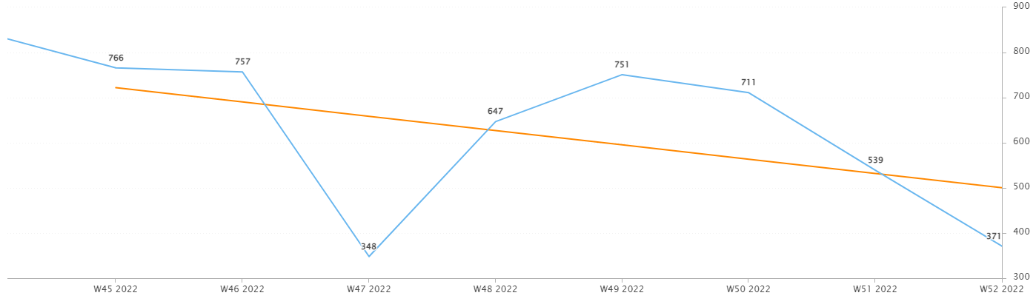
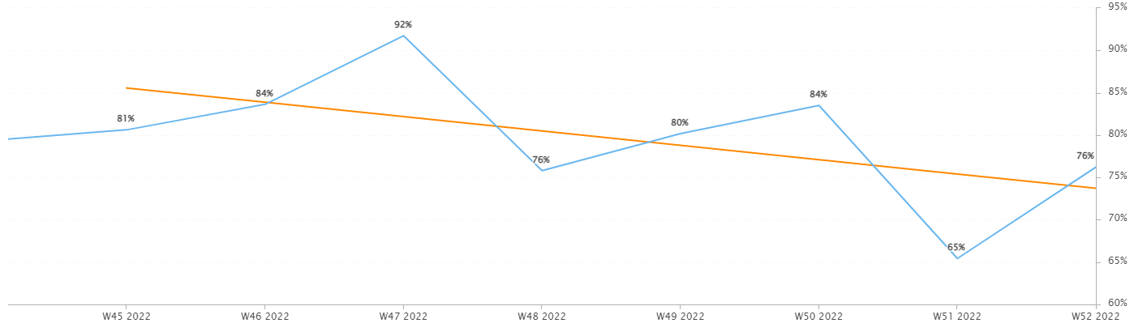
Incident Statistics
Incidents Opened by Week
Incidents opened by week trended downward in December, due largely to the holiday weeks.
The percentage of incidents resolved the same day that they were opened trended downward this month, again due to the holiday.
Percentage of incidents resolved; same day opened.

Slide 9
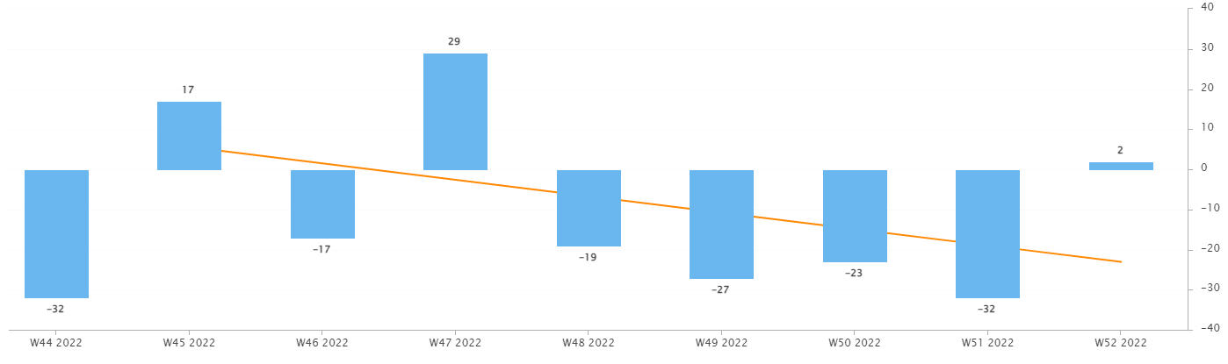
Incident Statistics
Open Incident Backlog Growth
In December, backlog growth trended downward. I’ve been pinging those with the oldest incidents and have been resolving items on behalf of other teams. Please remind your teams to work to resolve their assigned work.
As we approach 2023, we want to enter the new year with the smallest backlog as possible- across all teams. This applies to Problems as well.
Notes:
Backlog growth is a way of answering, “did we end the week with more or less incidents?”.

Slide 10
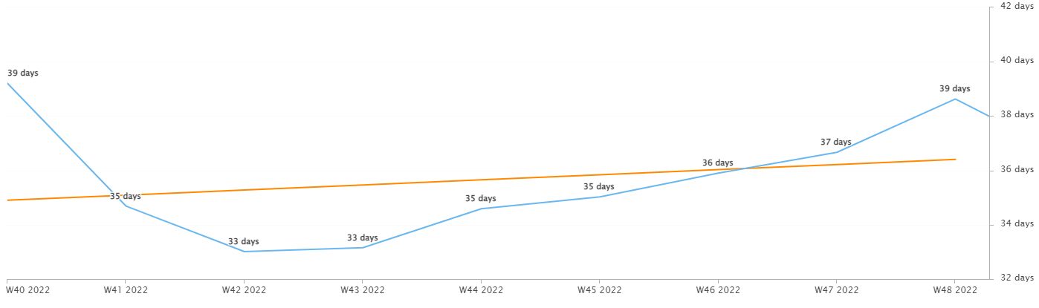
Incident Statistics
Average Age of Open Incidents
In December, the average age of open incidents steadily grew week over week.
Notes:
Please remind your teams to continue to work on their open incidents- this affects many of the previous slides as well as this one.

Slide 11
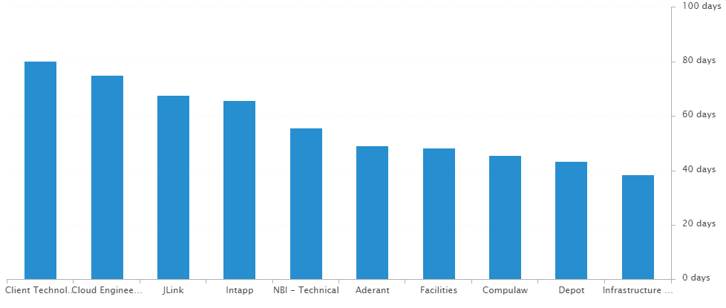
Incident Statistics
Average Age of Open Incidents by Assignment Group - as of the last day of the month

Slide 12
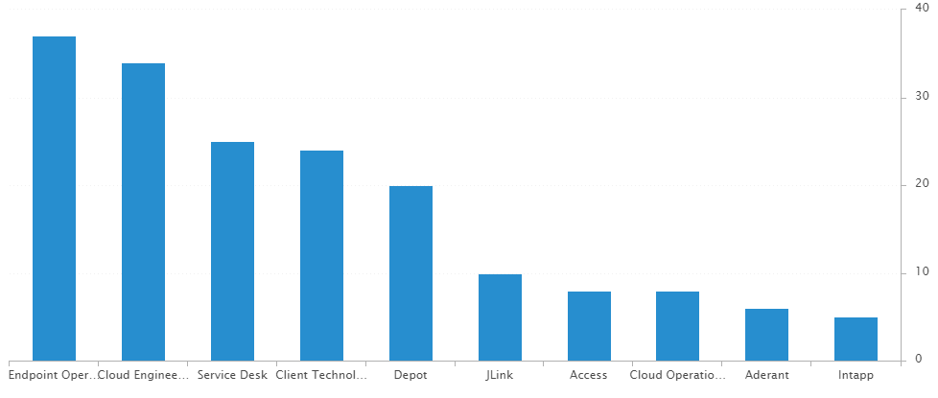
Incident Statistics
Open Incidents by Assignment Group - as of the last day of the month

Slide 13
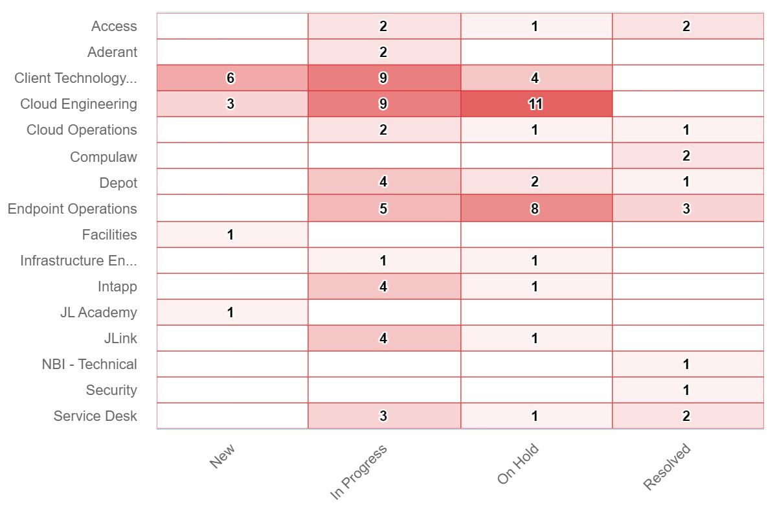
Incident Statistics
Open Incidents Older than 30 Days

Slide 14
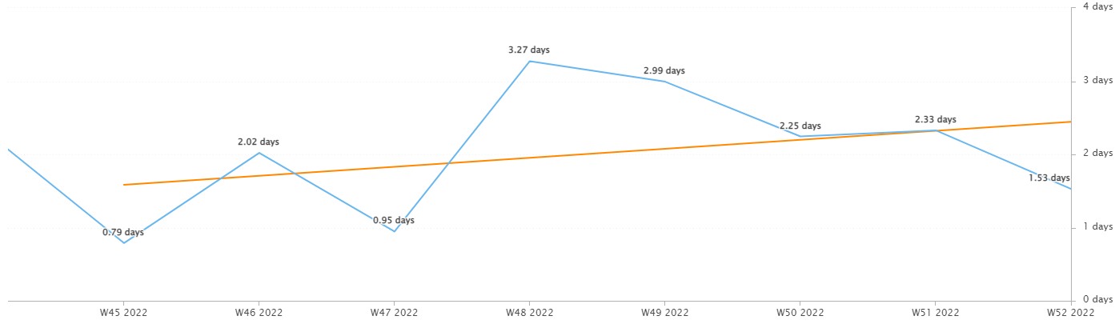
Incident Statistics
Average Resolution Time of All Resolved Incidents
The average resolution time trended upward across the month and lowered within the last week.

Slide 15
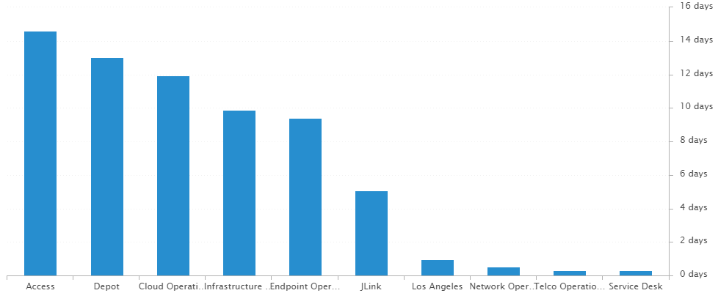
Incident Statistics
Average Resolution Time of Resolved Incidents, by Assignment Group

Slide 16
2022 SLA Goals & Actuals
Month | January | February | March | April | May | June | July | Aug | Sept | Oct | Nov | Dec
Goal | 90% | 90% | 90% | 90% | 90% | 90% | 90% | 90% | 90% | 90% | 90% | 90%
Actual | 88.8% | 88.1% | 92.7% | 92% | 90.6% | 93.9% | 91.6% | 91.2% | 90.7% | 89.9% | 91.5% | 89.2%
The Incident SLA goal was not met in December.
This was caused by older incidents being closed throughout the month, with their breached SLAs counting against the month they were completed within.

Slide 17
Problem Statistics
Open Problems
Problem | Date of most recent update | Assignment Group
PRB0010189 | 2022-10-12 | Cloud Engineering
PRB0010541 | 2022-07-20 | Security
PRB0010542 | 2022-07-27 | Intapp
PRB0010587 | 2022-12-14 | Cloud Engineering
PRB0010595 | 2022-08-31 | Telco Operations
PRB0010598 | 2022-12-05 | Cloud Engineering
PRB0010606 | 2022-12-07 | Endpoint Engineering
PRB0010617 | 2022-11-02 | Endpoint Operations
PRB0010634 | 2022-12-01 | Cloud Operations
PRB0010638 | 2022-10-28 | Infrastructure Engineering
PRB0010650 | 2022-12-05 | Access
PRB0010657 | 2022-01-03 | Cloud Engineering
Did you know?
PRB marked in Red have not been updated within the last month. ->

Slide 18
Service Desk

Slide 19
Year over Year Quarterly Results
Total incident and call volume reduced in Q4 2022 over 2021.

Slide 20
Key Call Statistics
Call volume dropped to 2169 calls in December. This drop is expected with less Problems opened than previous months and multiple holidays at the end of the year.
The goal was met, ending the month with 7.15%.
The abandonment rate monthly goal is 9%.
Notes:
~
There are several stats tracked for individual analysts as well as for the team and the org. Across the next few slides I’ll highlight some key statistics for the Service Desk team.

Slide 21
Key Call Statistics
The Service Desk met all 3 goals for each range. This correlates with the call volume and abandonment rates.
The goals for each time period:
70% of calls handled within 30 seconds.
75% of calls handled within 60 seconds.
80% of calls handled within 90 seconds.
Notes:
Over 75% of calls were handled within 30 seconds.
Over 80% were handled within 60 seconds.
Over 83% were handled within 90 seconds.
~
We track multiple metrics for calls handled- or how quickly a call is answered- within specific time periods. I’ve highlighted three here, calls handled within 30, 60, and 90 seconds.
The takeaway from these numbers should be that we are answering calls quickly which prevents calls from abandoning. Typically, we see the abandoned calls rise when these goals are not met- specifically the 60 seconds metric.

Slide 22
Key Call Statistics
The average speed to answer was 35 seconds which correlates with the trend of call volume & abandoned calls alongside the higher percentages for the calls handled within 30, 60, and 90 seconds.
Notes:
~
Average speed to answer is the average of how quickly all calls were answered by the Service Desk for the month.

Slide 23
Incident Statistics
Closed Monthly Data:
Incidents closed by SD: 2219
Total Closed Incidents: 2751
Closed by SD Percentage: 80.7%
Incidents closed by Service Desk, by Source:
Phone: 1677
Email: 497
Self-Service: 23
Walk-in: 19
Notes:
~
The typical methods for contacting the Service Desk are phone and email, which explains the results in the incident source chart.
Self-Service we hope to expand over the next year and drive users towards generating their own incidents and using the JL Service Center more actively.
Walk-ins are low month-to-month with the split schedule for Return to Better. But from analyst feedback incidents for walk-ins are not being opened consistently. I aim to correct this over the rest of this year. I’ve also added it as a 2022 goal for each analyst within their reviews.

Slide 24
Incident Statistics
Top 5 Subcategories:
Microsoft Office (521)
Active Directory (117)
NetDocuments (307)
Power PDF (113)
Windows OS (103)
Top 5 Customers:
Odette Jefferson (26)
Jing Tong (23)
Chris Gomez (17)
Suddie Scott (17)
Beth Davis (15)
Average Incident/employee/month: 1.5
Average Incident/new hire/month: 3.6
Notes:
Across the month _had the highest number of related incidents.
Top 5 customers in the month are listed here.
Looking at the chart, we’re tracking incident volume per new-hire per month and comparing this to last year.

Slide 25

2021 Service Desk SLA Statistics
Survey Response Comment Highlights:
“Blaise is great!”
Stephane - “I've always had outstanding support from our Help Desk! Many, many thanks to all the folks who work it. I couldn't do my job without you.”
“Everyone...especially Stéphane has been nothing short of patient and amazing with me“
Stephane - “You can't improve perfection :)”
Sandy – “Nothing to be improved - awesome job always! “
“Marcus Eatmon came to the rescue so I am very happy it is working now.”
“I have worked in several places and simply put none have been better. Quick service, almost immediate. Always fixes the problem and always friendly.”
September | Breached | Has not Breached | SLA %
Response | 97 | 2126 | 95.44%
Resolution | 37 | 2186 | 98.31%
Overall | 134 | 4312 | 96.89%
Response & Resolution SLA timers are determined by the Priority of the Incident.
Both Response and Resolution SLA reviewed on this slide are across all Priorities.
Notes:
Service level agreements/SLA
Response & Resolution SLA timers are determined by the Priority of the Incident.
Both Response and Resolution SLA reviewed on this slide are across all Priorities.
~ The Service Desk team is uniquely prepared to meet SLA goals. We generate incidents during calls, while emails generate their own incidents.

Slide 26
Knowledge Statistics
Top viewed articles, Self Service:
Azure Print - How to install a printer
How do I contact the Service Desk?
How to configure JL email on your iOS device
Using AnyConnect for Remote Access (VPN)
Top viewed articles, IT:
Escalation paths and category guide
Intapp Time Troubleshooting
Netskope – Web Filtering & Exceptions
Duo – enrollment process
Average Article rating: 4.67/5
Notes:
Knowledge within Service Now, is maintained by a few of us in the Service Desk team.
We evaluate resolved Incidents that have been flagged for knowledge.
On most of these flagged Incidents the fix or solution are not detailed by the escalated teams.
Knowledge is split into 2 sections. IT visible and Self-Service.
Please push your teams to write out the steps taken to resolve an issue, whenever possible.
This helps with knowledge but also helps when a user has a repeat issue, or the issue occurs for another user.
Reminder: your teams can generate their own knowledge articles. These will be used to increase our first call resolution and avoid escalating incidents.

Slide 27
Update & Reminder Highlights
Phishing Campaign: The next phishing campaign from Security will take place on December 5th. See the table below for details.
Priority in SNOW: Please remember to adjust the Impact/Urgency fields within your incidents when escalating. Technology Operations is trying to work the highest priority first, followed by first in/first out. I want to be sure we’re giving them the right information as they receive these incidents.
Workday: Please remember to redirect users to Workday Help when they have issues with functions of Workday. We should assist with login. Issues that we can’t resolve on first call should be redirected to Workday Help instead of escalating within IT.
Loaner Laptops: Seeing reports of loaners with full disk space, likely due to OneDrive being used and that standard drives are 256GB (before formatting).
Egress: With Egress going out to more offices this week, please be sure you’re up to speed with this add-in
Please refer to the knowledge articles or the emails sent regarding Egress.
Egress is not blocking anything at this time, just collecting metadata.
These updates and more are available here.
Notes:
Some highlights from the month’s U&R emails are listed here.
One to two emails are sent a week to the Service Desk reminding them, or updating them on, changes to existing workflows or policies. Quick notes sent via Teams are also rolled up into these emails to be sure that these points are not missed. All U&R emails are listed in Confluence for reference by other teams.

Slide 28
Technology Operations

Slide 29
Escalation Status

Slide 30
Escalation Baselines

Slide 31
Logic Monitor Alerts
Critical Alerts:
San Diego Office move (in SDT) recorded 45 critical alerts
Cloctimizer ( in SDT) recorded 30 critical alerts
Error Alerts:
816 alerts CPU Spikes
Vm-caris-col-01 ( Varonis Azure VM)
vm-eus2-mat02 ( Matallion Azure VM)
Azure Domain Controllers
JL-SN-MID-E01 ( Service Now discovery Server)
245 Alerts on Silver Peaks
376 Alerts on Reboots ( Servers failed to be placed In SDT)
288 Alerts on Idle Interval Citrix Desktop Servers

Slide 32
Resource Uptime
Resource | October | November | December
Aderant | 99.992% | 99.992% | 100%
Intapp Walls | 100% | 100% | 99.996%
JL - Home | 99.934% | 99.973% | 97.579%
JLink | 99.993% | 99.996% | 100%
NBI | 99.938% | 99.989% | 97.577%
Payments Credit Card | 100% | 100% | 100%
Dashboard | 99.998% | 100% | 99.997%
Biscom | 100% | 100% | 99.958%
Citrix | 99.987% | 100% | 99.964%
VPN East | 100% | 100% | 99.96%
VPN West | 99.982% | 100% | 100%
Logic Monitor Collector Polling
Improvements hitting 100% with some websites
NBI blimps of errors status code
JL – Home – Authorize timeout during 12/11 5pm EST to 12/12 7am EST

Slide 33
Endpoint Engineering

Slide 34
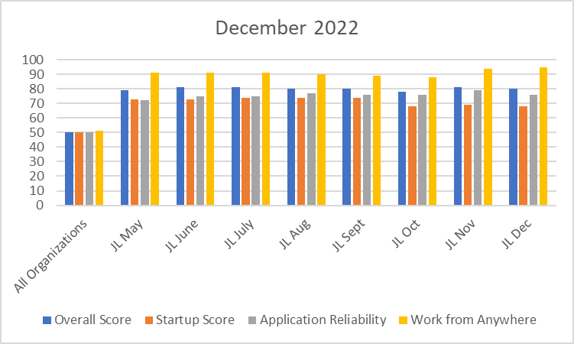
Endpoint Analytics
Overall score fell one point to 80 from November primarily due to Feature Updates as we push 22H2 out to the fleet.
App Reliability score of 76 due to multiple firmwide deployments in December that need to initialize on first launch.
Work From Anywhere score rose to 95 as more of our PCs are redirected to our new SCCM CMG.

Slide 35
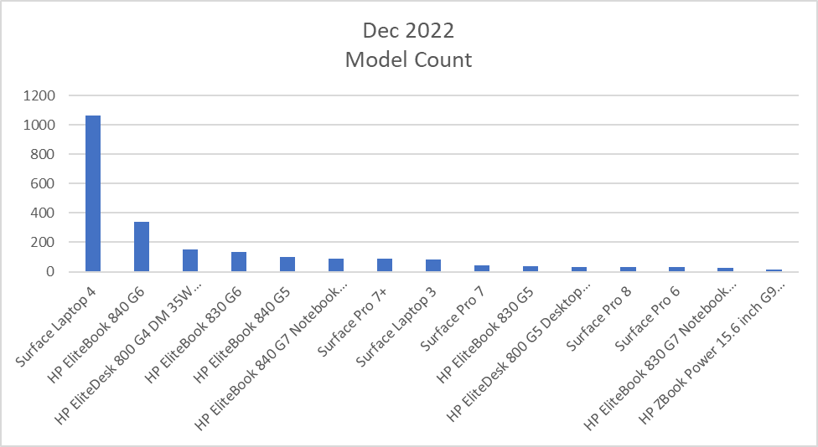
Endpoint Model Inventory
1063 units of Surface Laptop 4 continues to improve performance and stability.
1044 total Surface Laptop 4s – Best overall performer
2 Remaining Surface Pro 5s - Worst overall performer

Slide 36
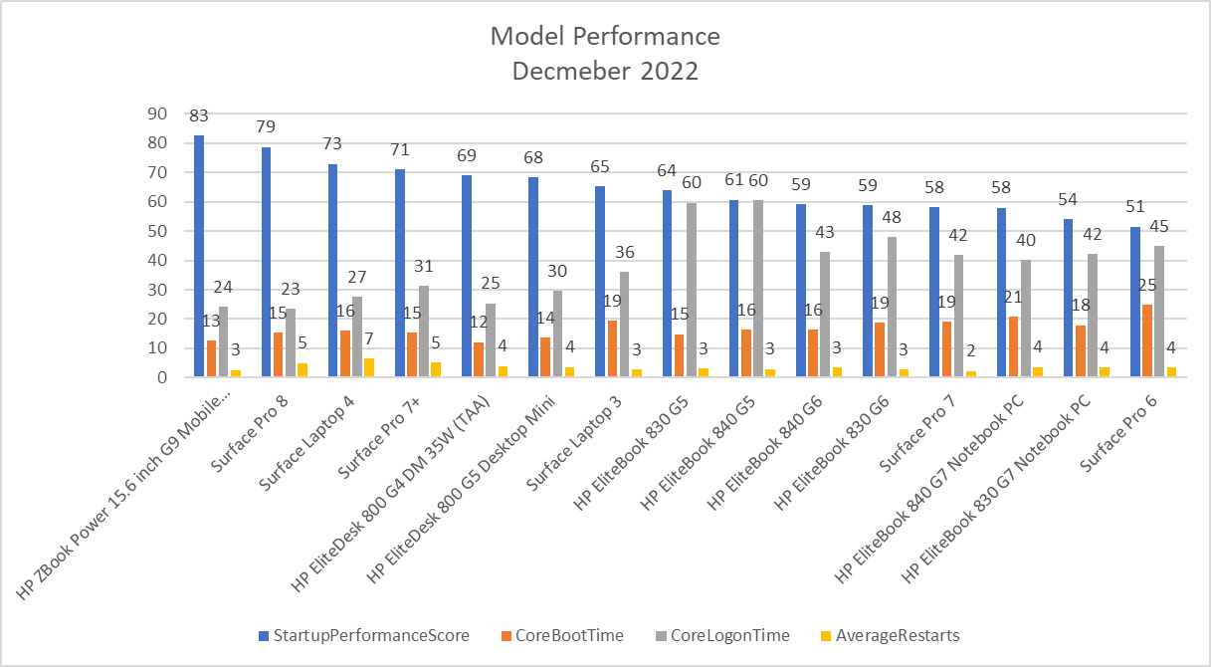
Endpoint Model Performance
Our latest models continue to lead in performance, decreasing boot and sign on times for users.

